Slide 1
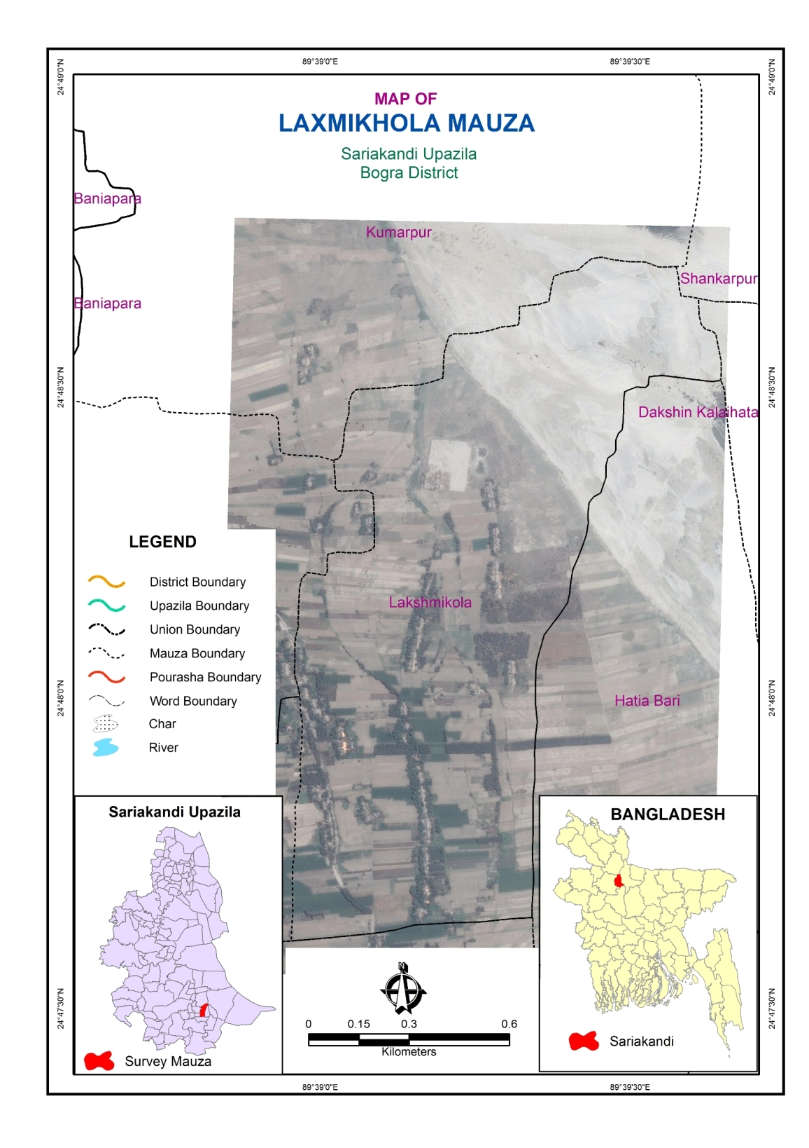
In some places the microplanning may be possible without visiting the clusters, using excellent maps & Google Earth
Elsewhere an early visit will be necessary to make a good map and randomly select a segment to sample
2
3
1
4
5
6
PSU segments 1-6 defined using easy-to-identify features that define groups of roughly the right number of households

